Slide 1
Quantarks Chat Application
Sahil Lalani (212308043)
Internal Guide: Dr. Dhiren Patel
Department of Computer Science
Gujarat Vidyapith

Slide 2
Index
Introduction
Project Overview
Objectives
Development Environment
Diagrams
Data Dictionary
Screenshots
Limitations
Future Scope
References

Slide 3
Introduction
Developed during Summer Internship at Sparks to Ideas
Purpose: Seamless, instant communication across platforms using Flutter & Firebase.
Core Features:
Real-time one-on-one messaging.
Search and filter users by name or city.
Media sharing capabilities.
Technology Stack:
Flutter: Cross-platform, responsive UI for Android, iOS, web, and desktop.
Firebase: Authentication, real-time database, cloud storage, scalability.

Slide 4
Project Overview
Key Features:
Instant one-on-one messaging.
Media sharing (images) stored securely in Firebase Cloud Storage.
User search and filter by name/location.
Real-time presence updates (online/offline status).
Edit profile
Change password
Forget password
Feedback/help
Security:
Firebase Authentication for secure login/registration.
Built-in Firebase security rules and data encryption.

Slide 5
Objectives
• Real-Time Communication To implement real-time messaging between users using Firebase's Realtime Database or Cloud Firestore, ensuring instant message delivery and seamless updates within the chat interface.
• Cross-Platform Compatibility To create a seamless user experience on Android, iOS, Web, and Desktop platforms by using Flutter, providing a consistent, optimized chat interface across different devices.
• User Authentication with Firebase To integrate Firebase Authentication for secure user login and registration. This will include options like email/password authentication, with future plans for phone and third-party logins such as Google and Facebook.

Slide 6
• Message Management and Storage To store and manage messages in Firebase Firestore or Realtime Database, allowing users to access chat history and synchronize messages in real-time. Additionally, users will be able to share images through Firebase Cloud Storage.
• Responsive User Interface (UI) To develop a clean and intuitive user interface that works seamlessly on all devices, ensuring a user-friendly chat experience. The UI will include essential features such as a message input box, chat history, and user profile management.
• User Status To show users' online/offline status in real time, allowing them to know the availability of their contacts.
• Search and Filter To enable users to search for others by name or city, with the ability to filter the displayed users by city.

Slide 7
Development Environment
Category | Software/Tools | Version/Details
Frontend Development | Flutter SDK | Version: 3.0.0 or above
 | Dart | Version: 2.10 or above
 | Android Studio | Version: Latest stable release
Backend Development | Firebase (Firebase Authentication, Firestore, Firebase Storage) | Firebase SDK for Flutter, Latest Version
 | Firebase CLI | Latest Version
Operating System | Windows 11 | Latest stable version of Windows 11
Web Development | Google Chrome or any modern browser for testing and debugging | Latest stable version
Version Control | Git | Version: 2.x and above
Database | Firebase Realtime Database or Firestore | Firebase Hosting & Firestore SDK
Deployment | Firebase Console (for deployment and management) | Web-based console, Latest Version

Slide 8
Hardware/Resources
The Quantarks Chat Application was developed on a system with an Intel Core i3 processor, 12 GB of RAM, and a Solid State Drive (SSD). The system runs on Windows 11, providing a stable environment for development with efficient performance for Android Studio and other tools.

Slide 9
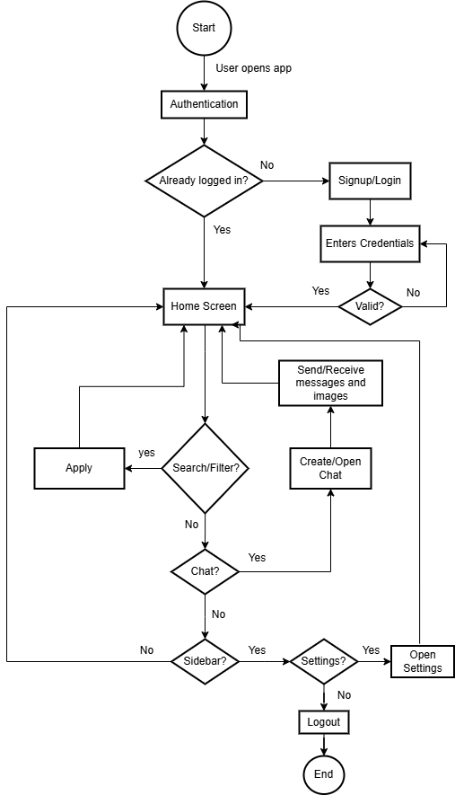
Diagrams
System Flowchart

Slide 10
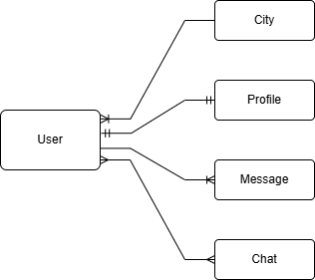
ER Diagram

Slide 11
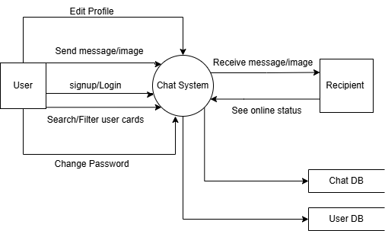
Data flow diagram(DFD) - Level 0

Slide 12
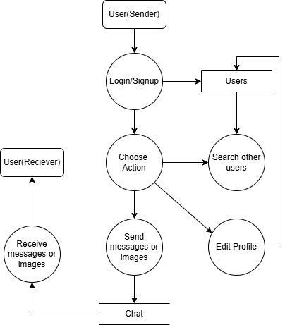
DFD(Level 1)

Slide 13
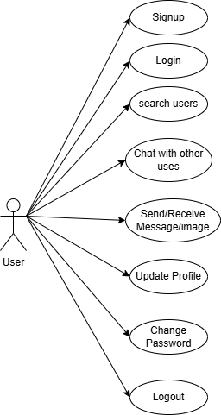
Usecase Diagram

Slide 14
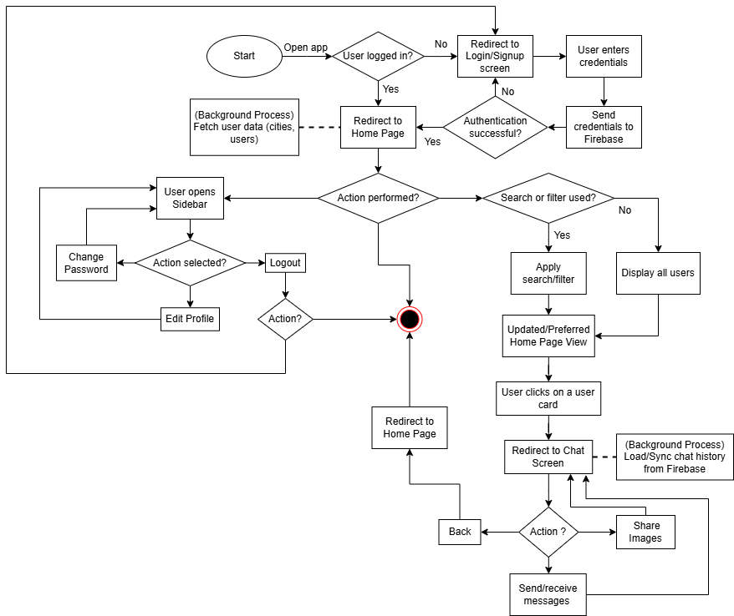
Activity Diagram

Slide 15
Data Dictionary
Collection: chat
Field Name | Data Type | Description
createdAt | timestamp | The timestamp indicating when the chat was created.
users | array of strings | Array containing the user IDs of the participants in the chat.
Sub-Collection: messages
Field Name | Data Type | Description
recipientId | string | The user ID of the recipient of the message.
senderId | string | The user ID of the sender of the message.
text | string | The content of the message sent in the chat.
timestamp | timestamp | The timestamp indicating when the message was sent.
type | string | The type of message (e.g., text, image, video).

Slide 16
Collection: users
Field Name | Data Type | Description
email | string | The email address of the user.
Name | string | The name of the user.
City | string | The city where the user resides.
Status | string | The user status(online/offline)
Sub-Collection: feedback
Field Name | Data Type | Description
email | string | The email address of the user who submitted the feedback.
Review | string | The review or feedback content provided by the user.

Slide 17
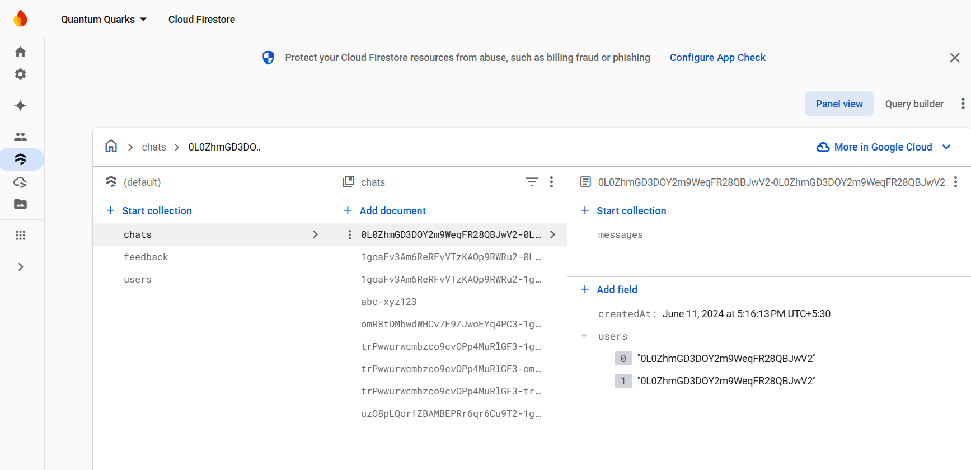
Collections: chats

Slide 18
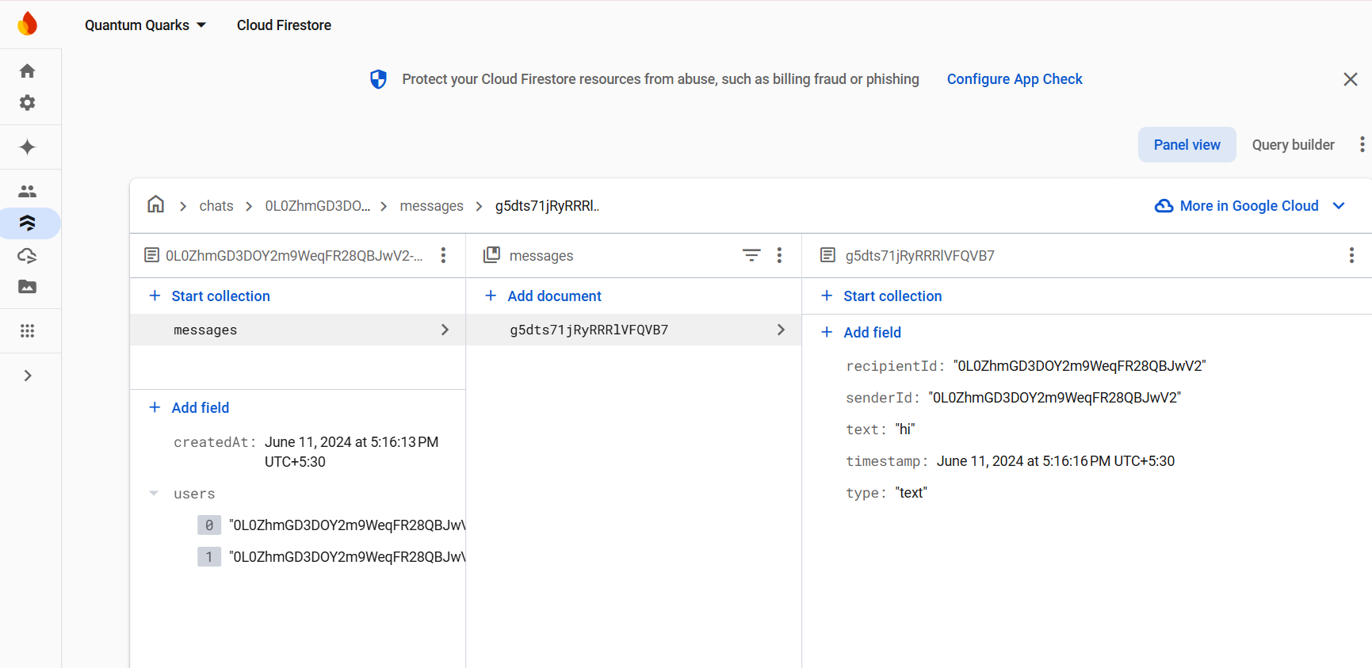
Collections: messages

Slide 19
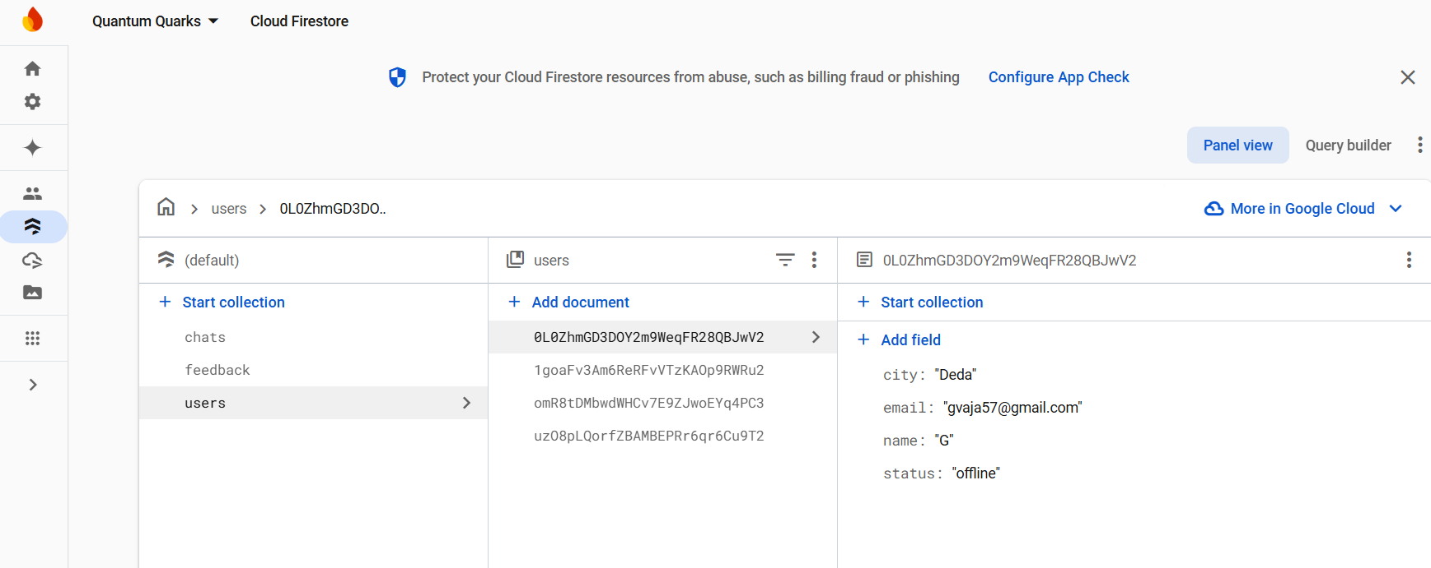
Collections: users

Slide 20
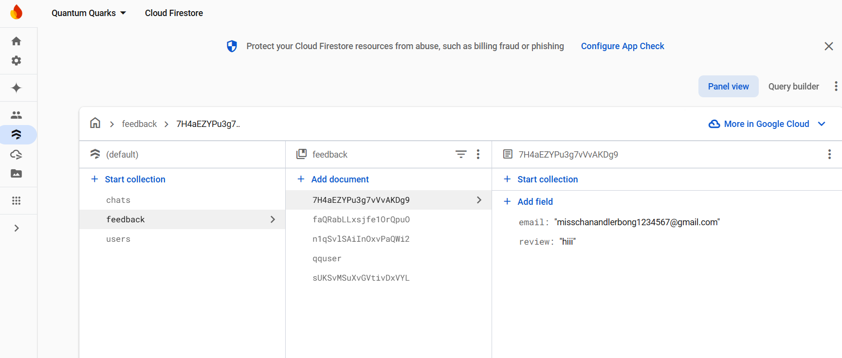
Collections: feedback

Slide 21
Screenshots

Slide 22
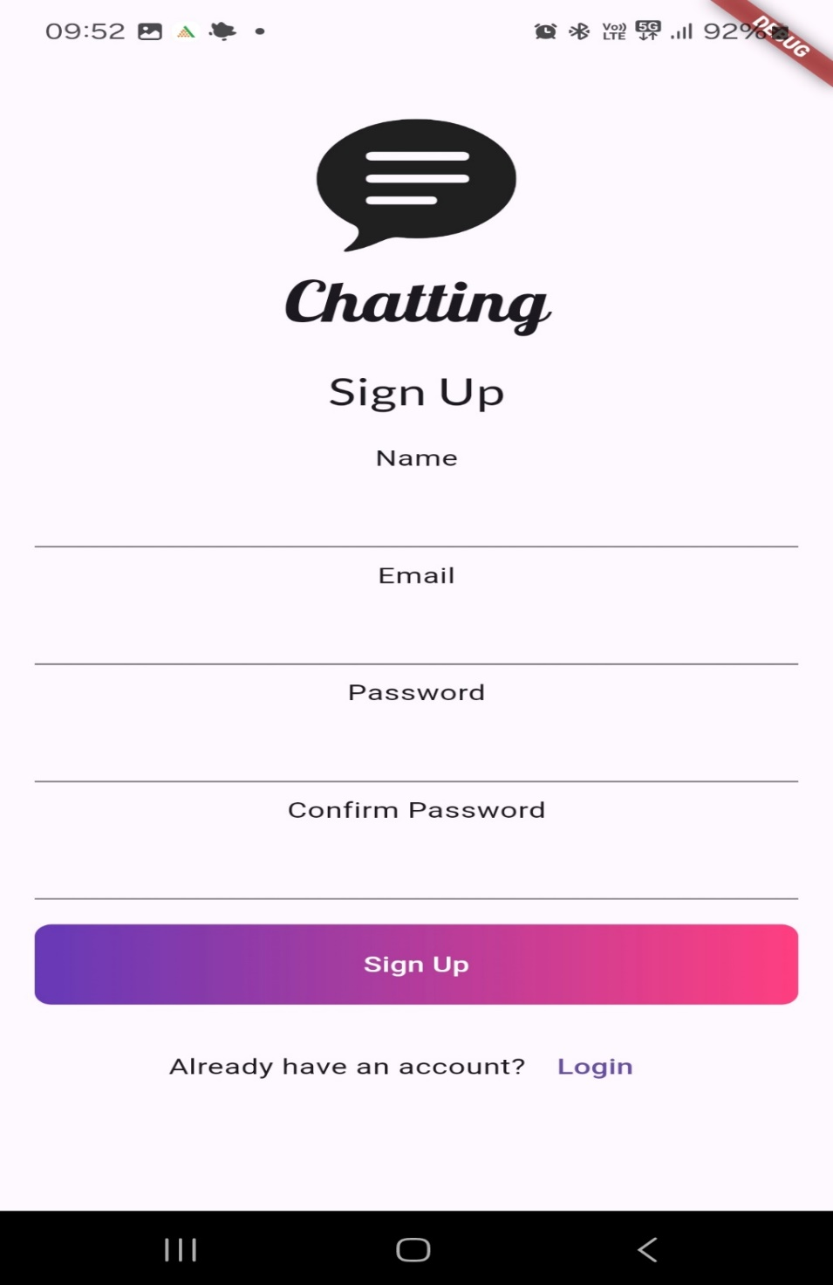
Signup

Slide 23
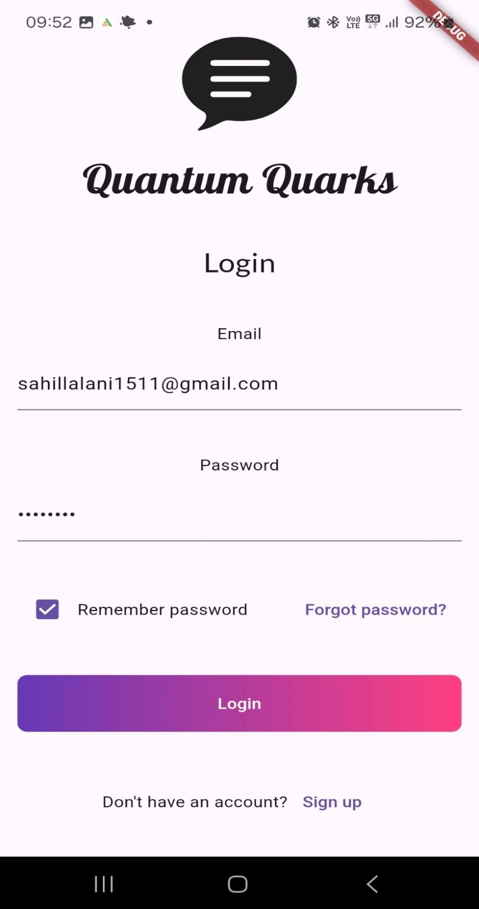
Login

Slide 24
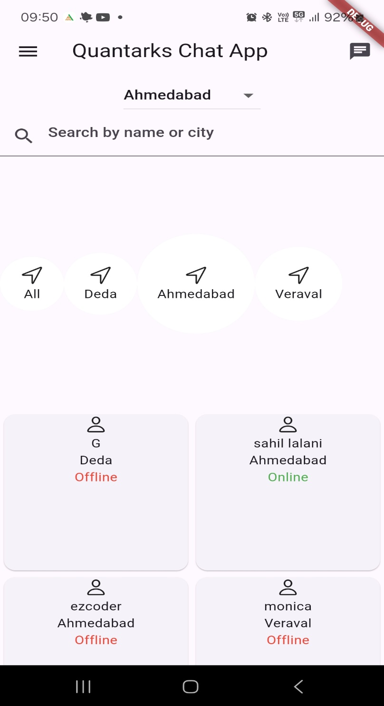
Home Screen

Slide 25
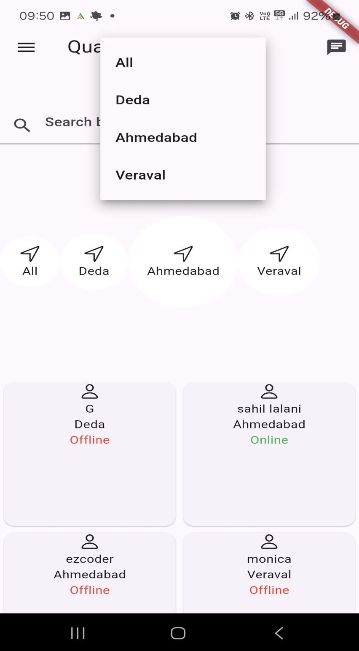
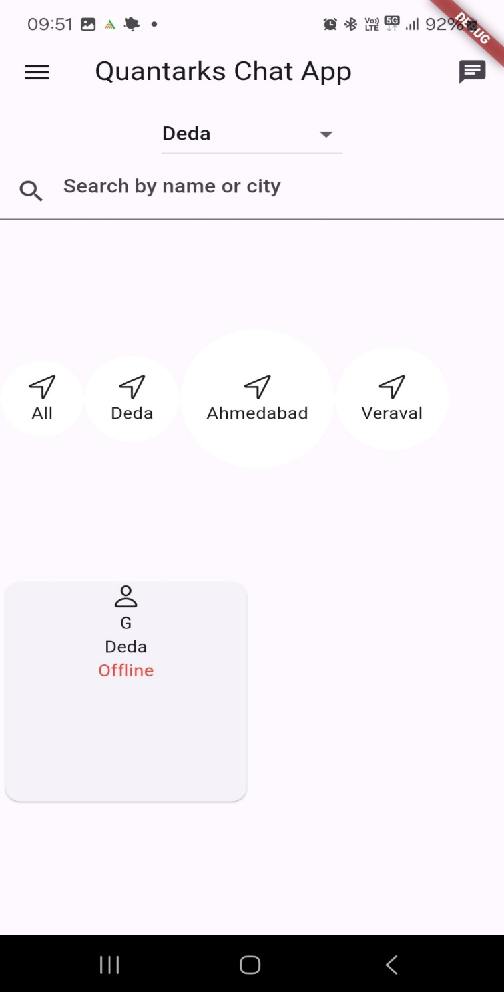
Search and Filter Screen

Slide 26
Home Screen

Slide 27
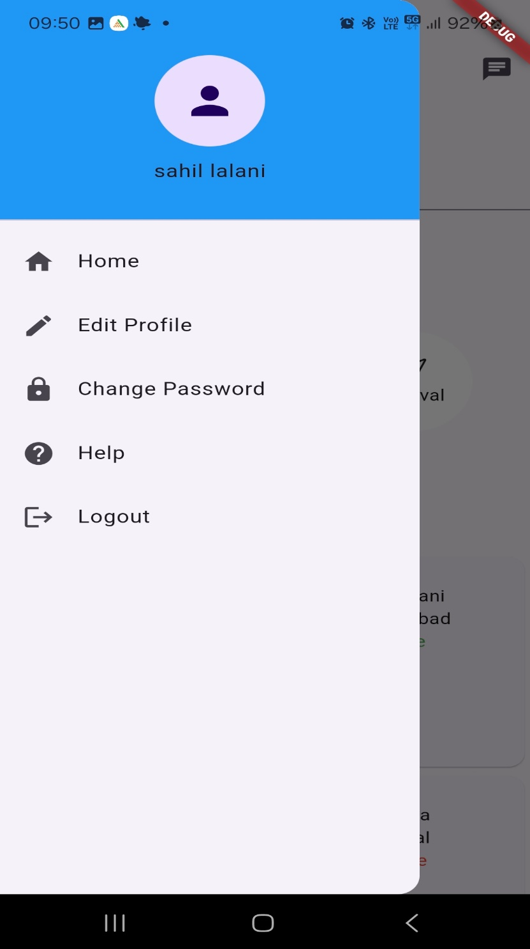
Home Screen Drawer

Slide 28
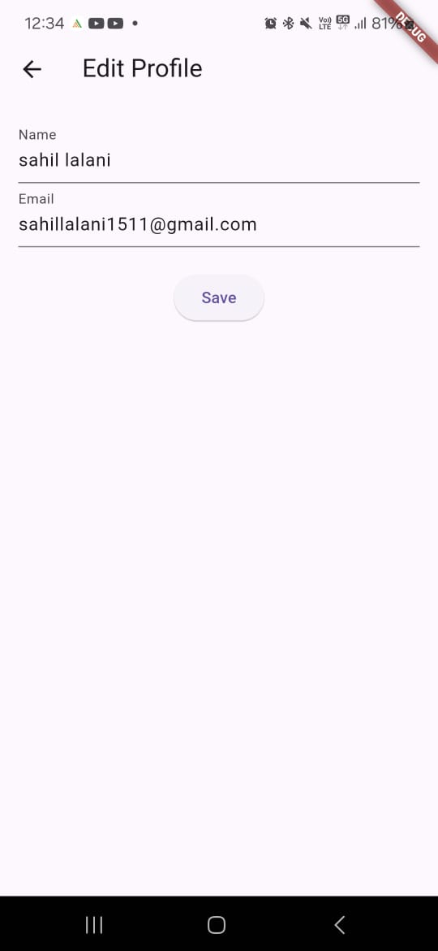
Edit Profile Screen

Slide 29
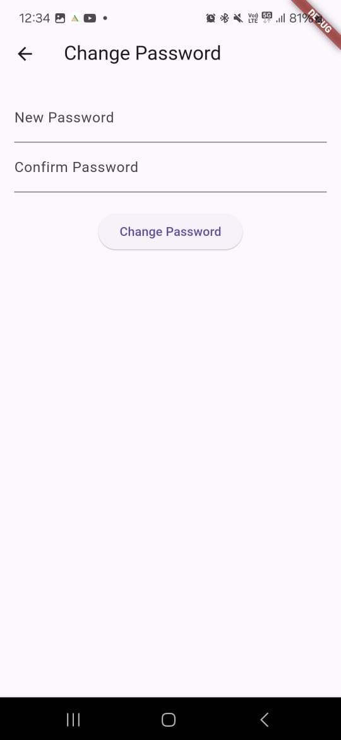
Change Password Screen

Slide 30
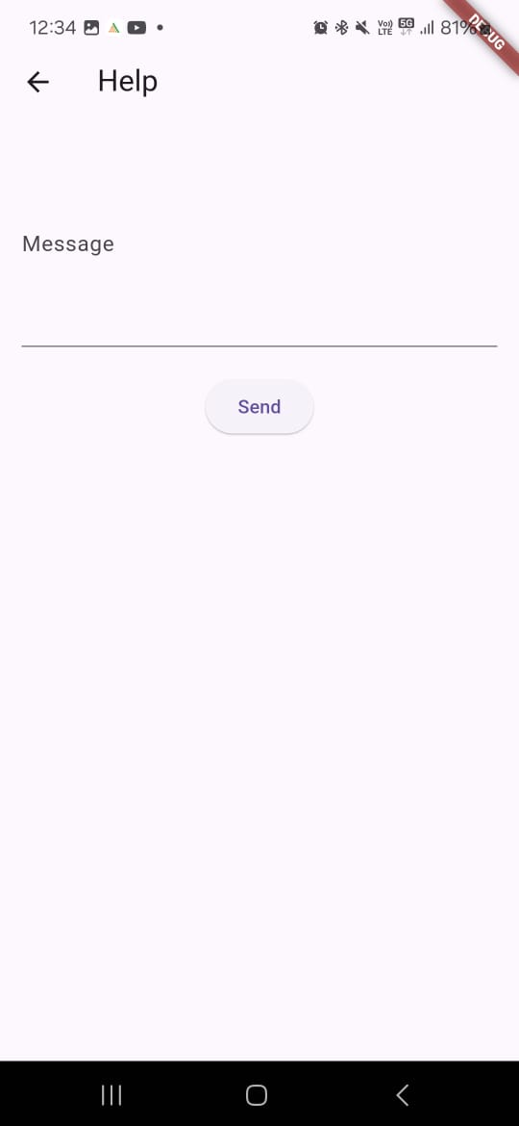
Help/Feedback Screen

Slide 31
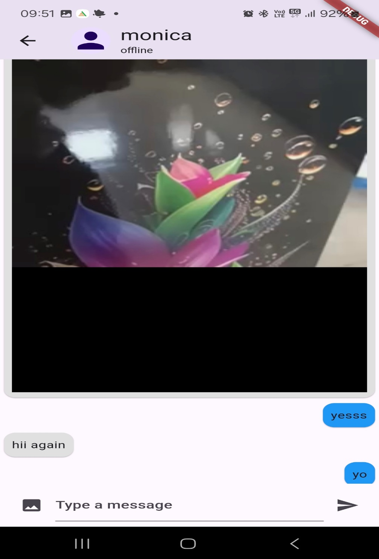
Chat Screen

Slide 32
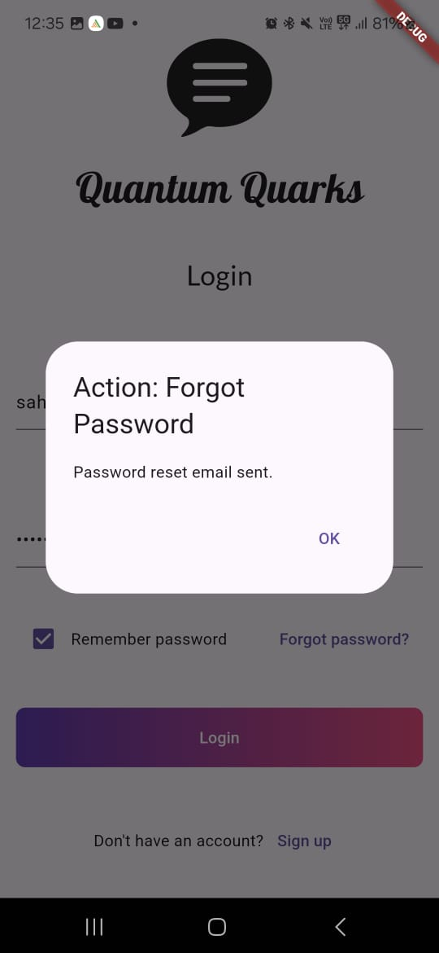
Forget Password Option

Slide 33
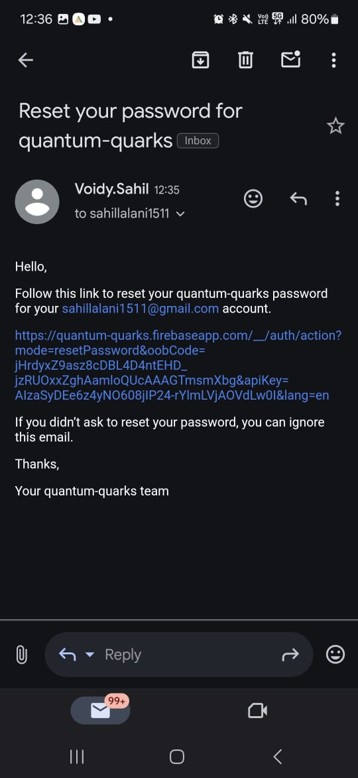
Email Link to Reset Password

Slide 34
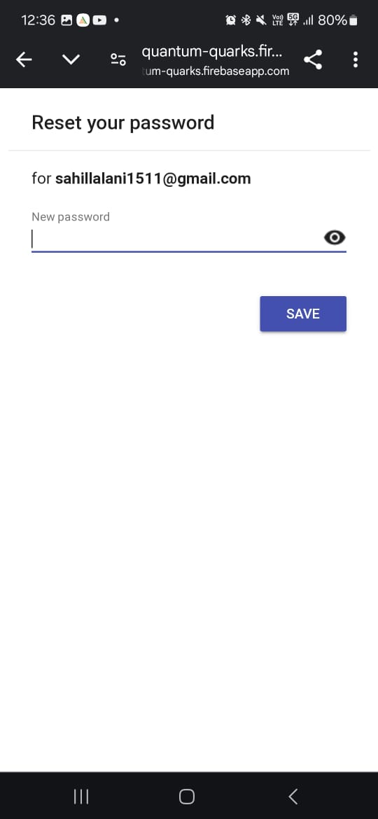
Reset Password page in Browser

Slide 35
Limitations
Lack of Notification System: The system currently does not support push notifications or real-time alerts for new messages. This limitation can lead to delayed communication, especially if users are not actively monitoring the app.
• Scalability Challenges: With an increasing number of users and messages, the system may face performance issues. Efficient database management and optimization techniques will be crucial to prevent delays and ensure smooth operation.
• Limited Media Support: The system does not allow multimedia file sharing such as images, videos, or documents. This restricts the type of communication users can engage in, which is a common feature in modern chat applications.

Slide 36
• Absence of End-to-End Encryption: While the system ensures basic security, it lacks advanced end-to-end encryption protocols, making it less suitable for users concerned about privacy.
• No Offline Functionality: Users cannot compose or view messages without an internet connection. This can be a significant limitation for users in areas with intermittent or limited connectivity.
• Limited Personalization: Users are currently unable to set profile images, create groups, or manage group chats. This restricts personalization and collaborative features, which are often expected in chat systems.

Slide 37
Future Scope
• Integration of Real-Time Notifications: Introducing push notifications to notify users of new messages instantly. This feature will enhance communication efficiency and improve the overall user experience.
• Enhanced Security Features: Incorporating end-to-end encryption to ensure user privacy and secure message transmission. Additional security measures like two-factor authentication can also bolster account protection.
• Support for Multimedia Communication: Upgrading the system to support the exchange of media files, such as images, videos, and documents, which will diversify the communication options available to users.
• AI-Based Chat Assistance: Adding features like chatbots for automated responses and customer support. AI-driven message suggestions and assistance can further improve user engagement and functionality.

Slide 38
• Cross-Platform Compatibility: Expanding the application to work seamlessly on web and desktop platforms, allowing users to access the system from various devices.
• Scalability Improvements: Implementing a microservices architecture and leveraging cloud-based solutions to handle increased user demand and data volume. This will ensure system reliability and performance as the user base grows.
• Offline Messaging: Developing offline functionality to enable users to draft messages without an active internet connection. Messages can be queued and sent once the user reconnects, enhancing usability in areas with limited connectivity.
• Group Chat Functionality: Adding support for group creation and management to enable collaborative conversations. This includes features like group messaging, member management, and assigning group roles.
• Profile Image Customization: Allowing users to set and update profile images for better personalization and a more interactive user experience.

Slide 39
References
https://flutter.dev/
https://dart.dev/
https://firebase.google.com/docs/
https://www.youtube.com/c/flutterdev/videos

Slide 40
Thank You, Appreciate Your Time

